Slide 1
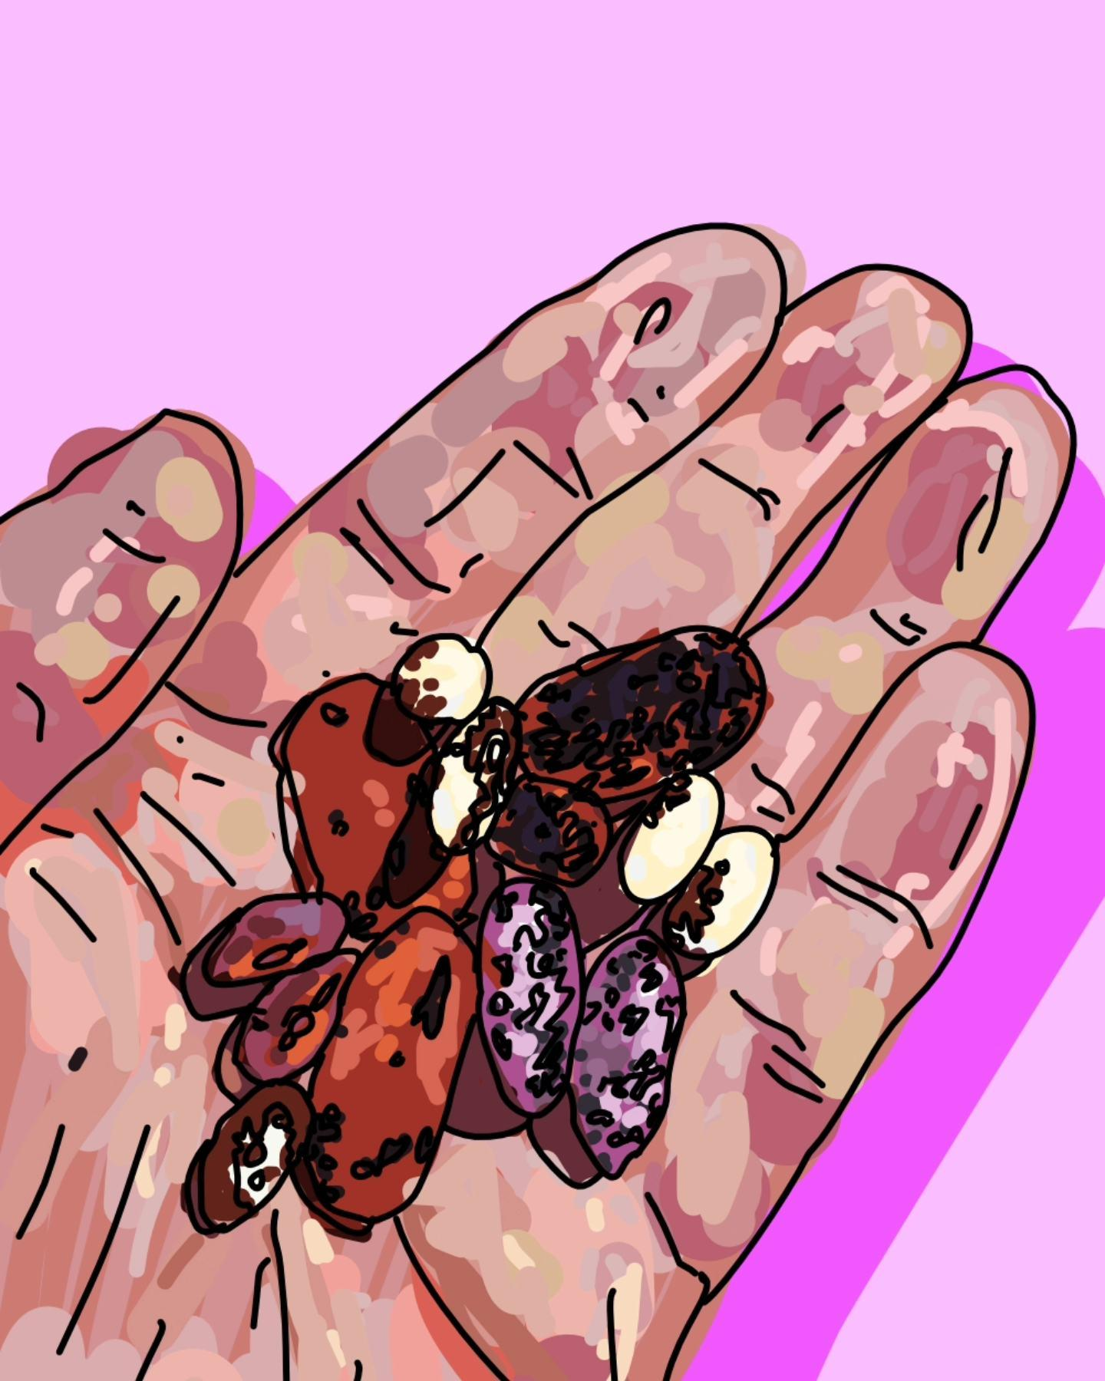

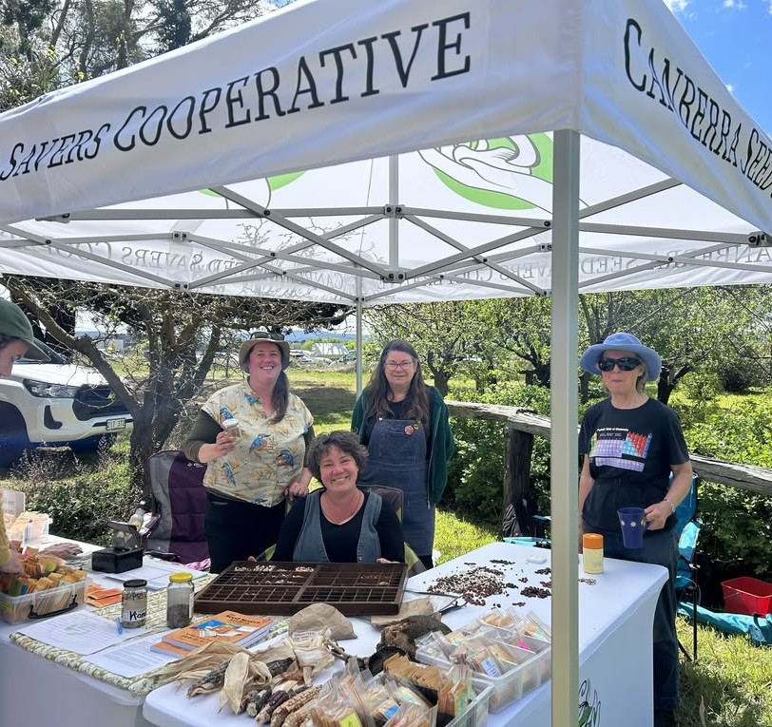
www.canberraseedsavers.org.au
hello@canberraseedsavers.org.au
Notes:
Canberra Seed Savers - who we are, what we do and why we do it

Slide 2
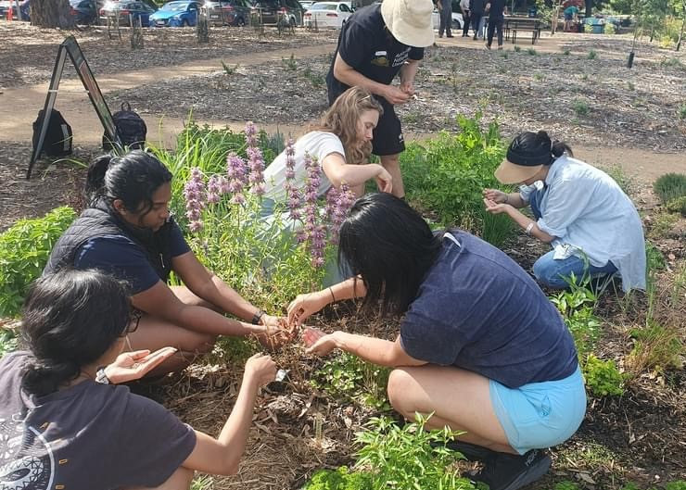
Why save seeds?
Basics of seed saving
Wet & dry seed processing
How to get started this season!

Slide 3
Heirloom seeds are our common heritage – they shouldn’t be commodified or corporately controlled, they belong to everyone.
Seeds are life – from each little seed comes all the genetic information for a new plant, flowers, fruit, seeds and on and on. Seeds are the basis of our food system.
It’s cheap, easy and fun! Save money!
Some thoughts on seed saving & why save seeds
Seeds are saved most sustainably when they are grown & shared – seeds need to grow and change, not sit in a box or a fridge.
Build community & environmental resilience
Seeds represent abundance – a single, tiny lettuce seed grown to maturity will produce thousands more lettuce seeds and plants!
Protect biodiversity
Notes:
There’s lots of ways to think about seed saving. Canberra Seed Savers is building a living seed bank by working cooperatively as a community of growers and farmers to grow vegies and herbs from seed, eat the great food we grow and select, save and share seeds for the next season.
We want to keep seeds growing and being shared across our network so they adapt to our local climate and to climate change, so that we as a community keep control of our common wealth of open pollinated food seeds, so that we can work together with other growers to increase our community resilience and because it’s fun, cheaper than buying seeds every season and means you can grow really interesting stuff!
Why save

Slide 4
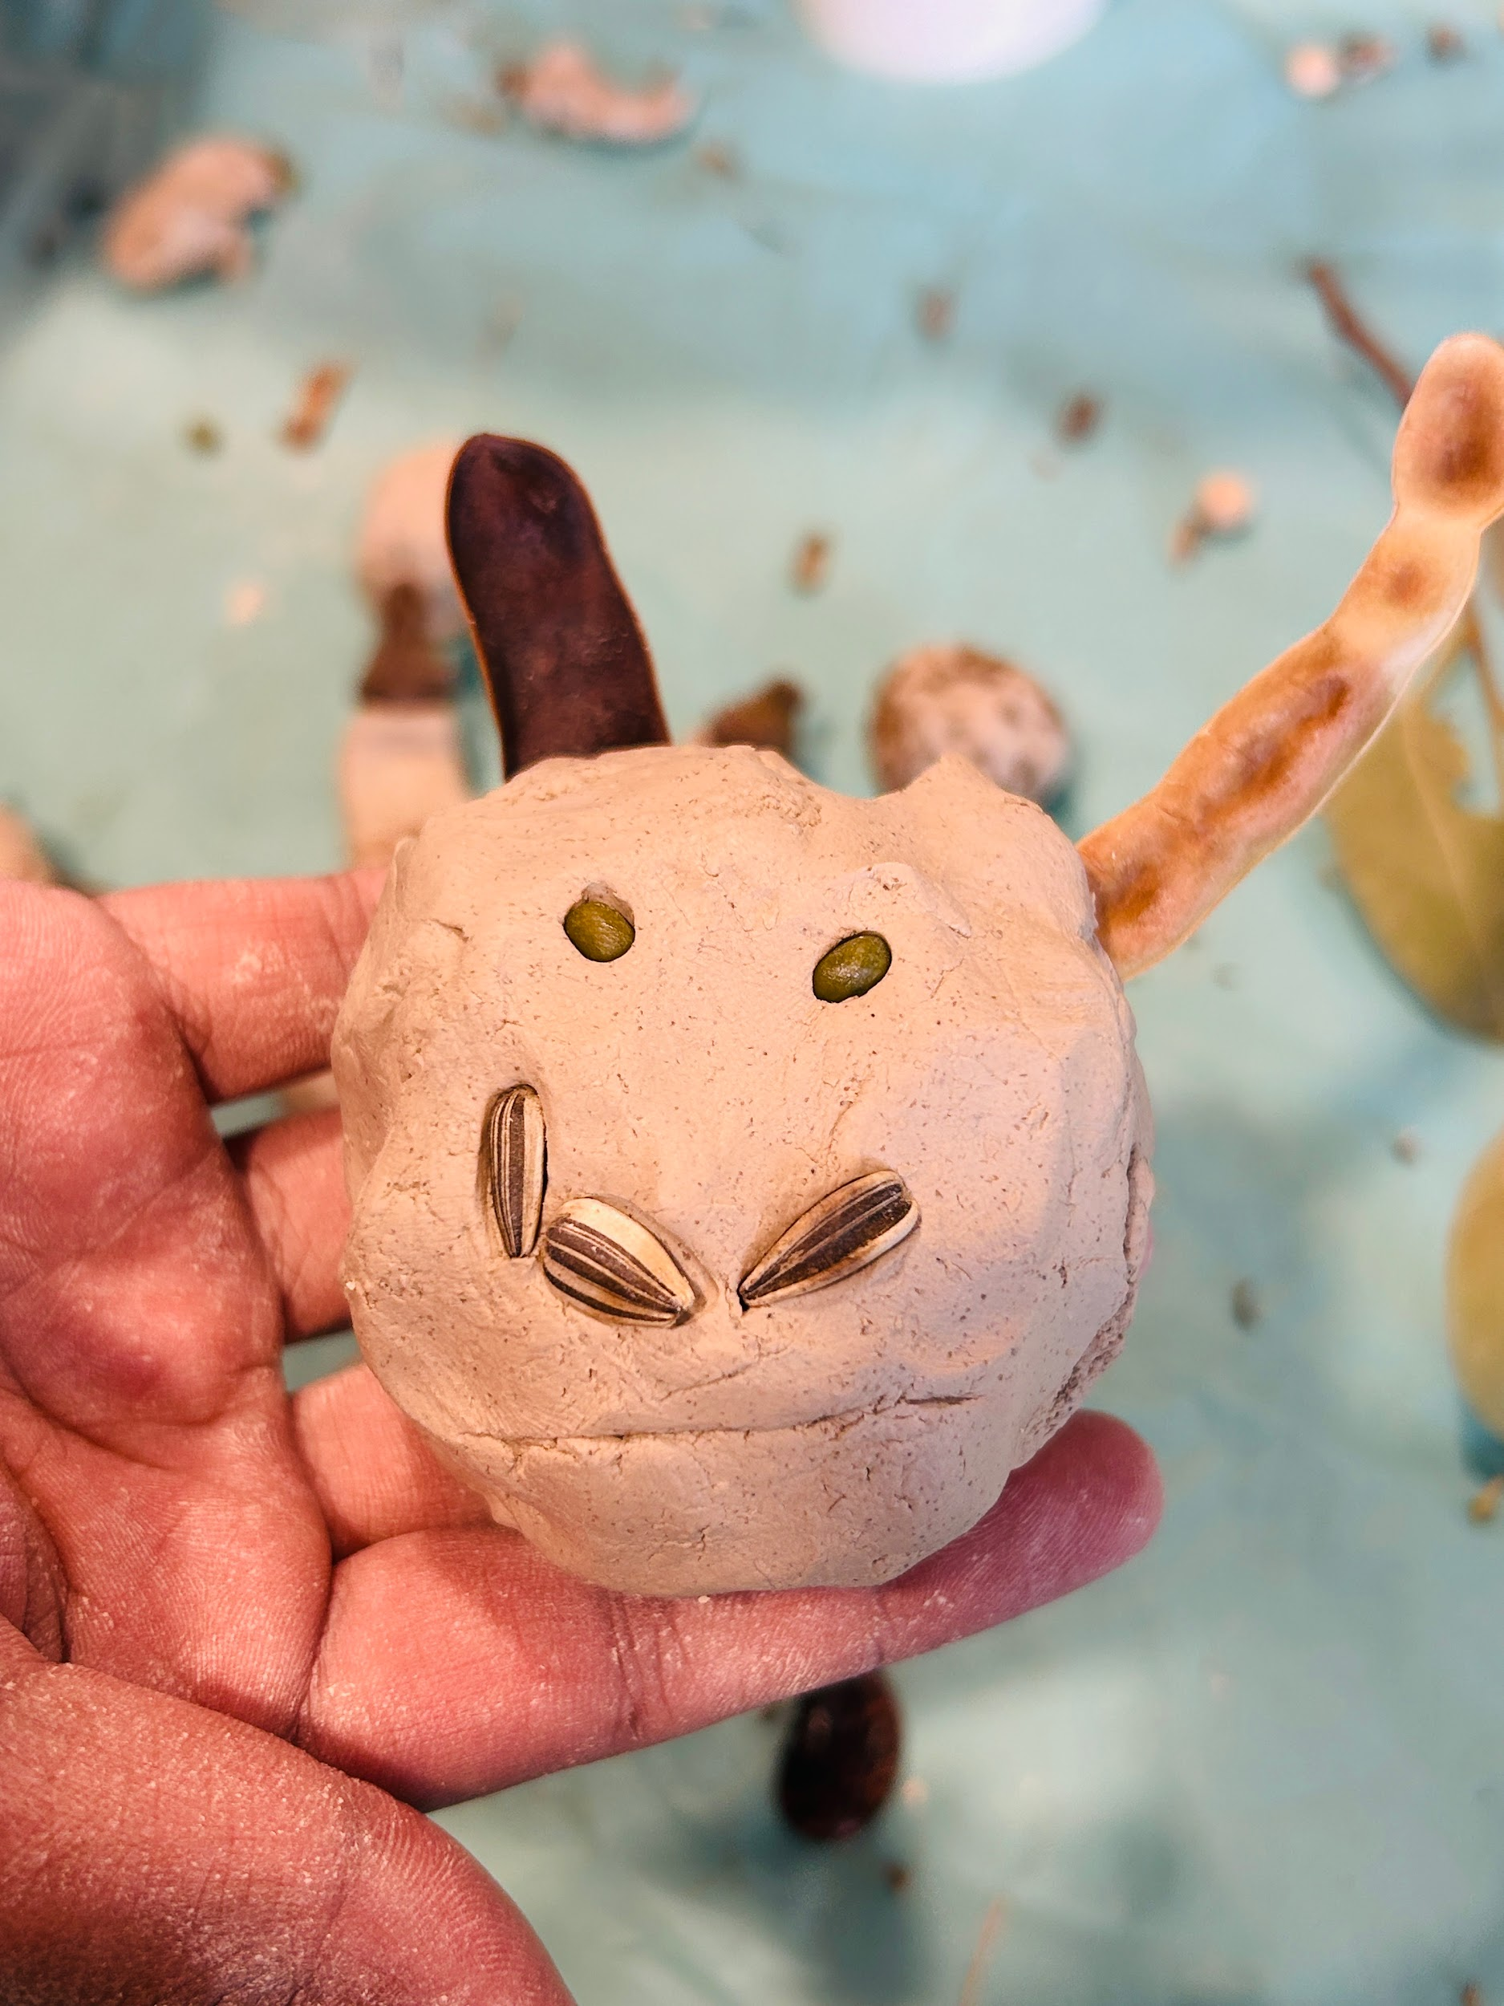
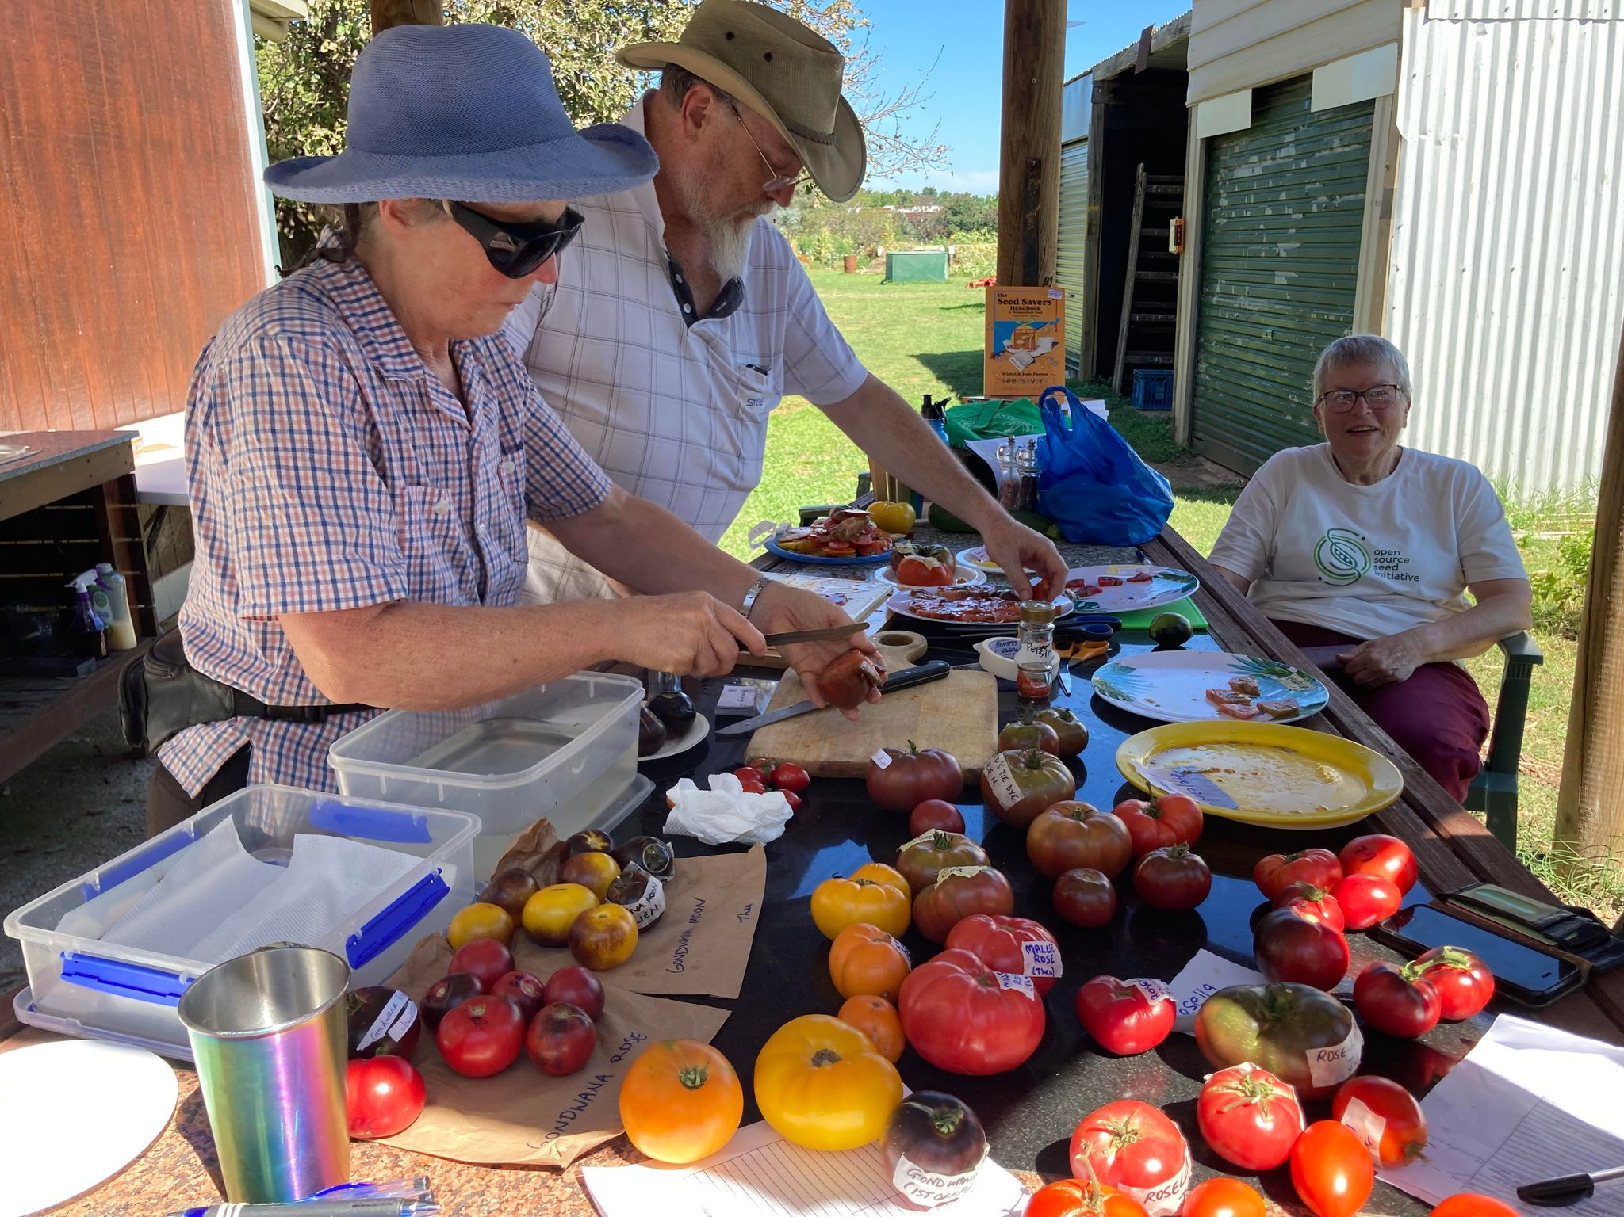
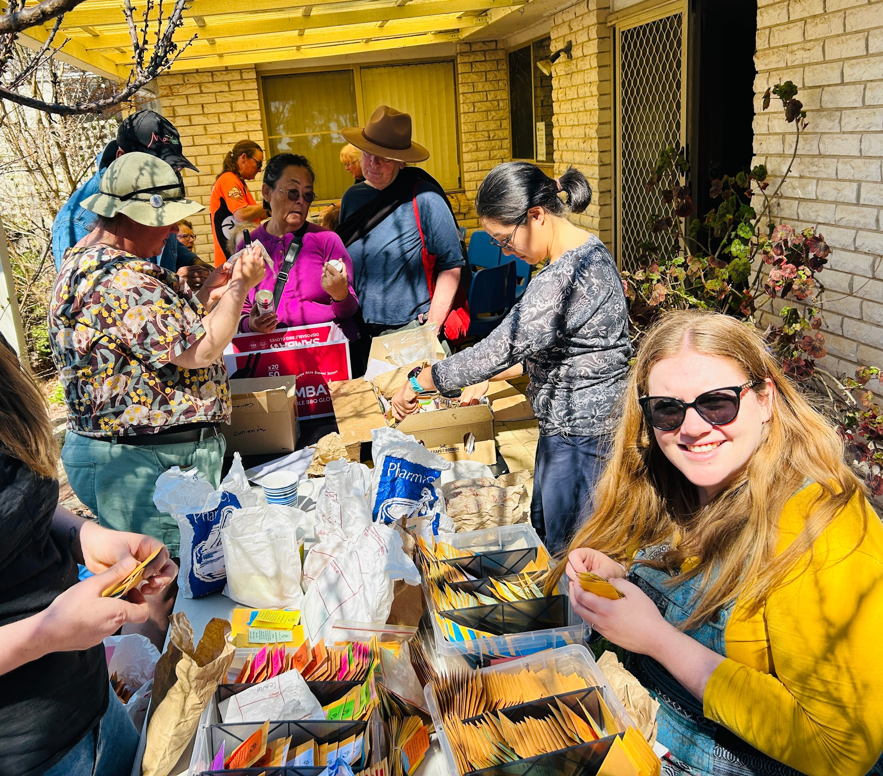
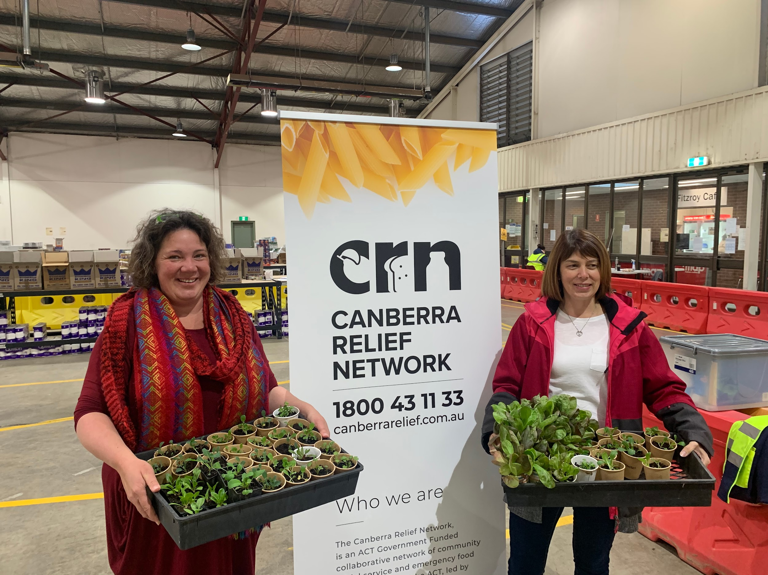
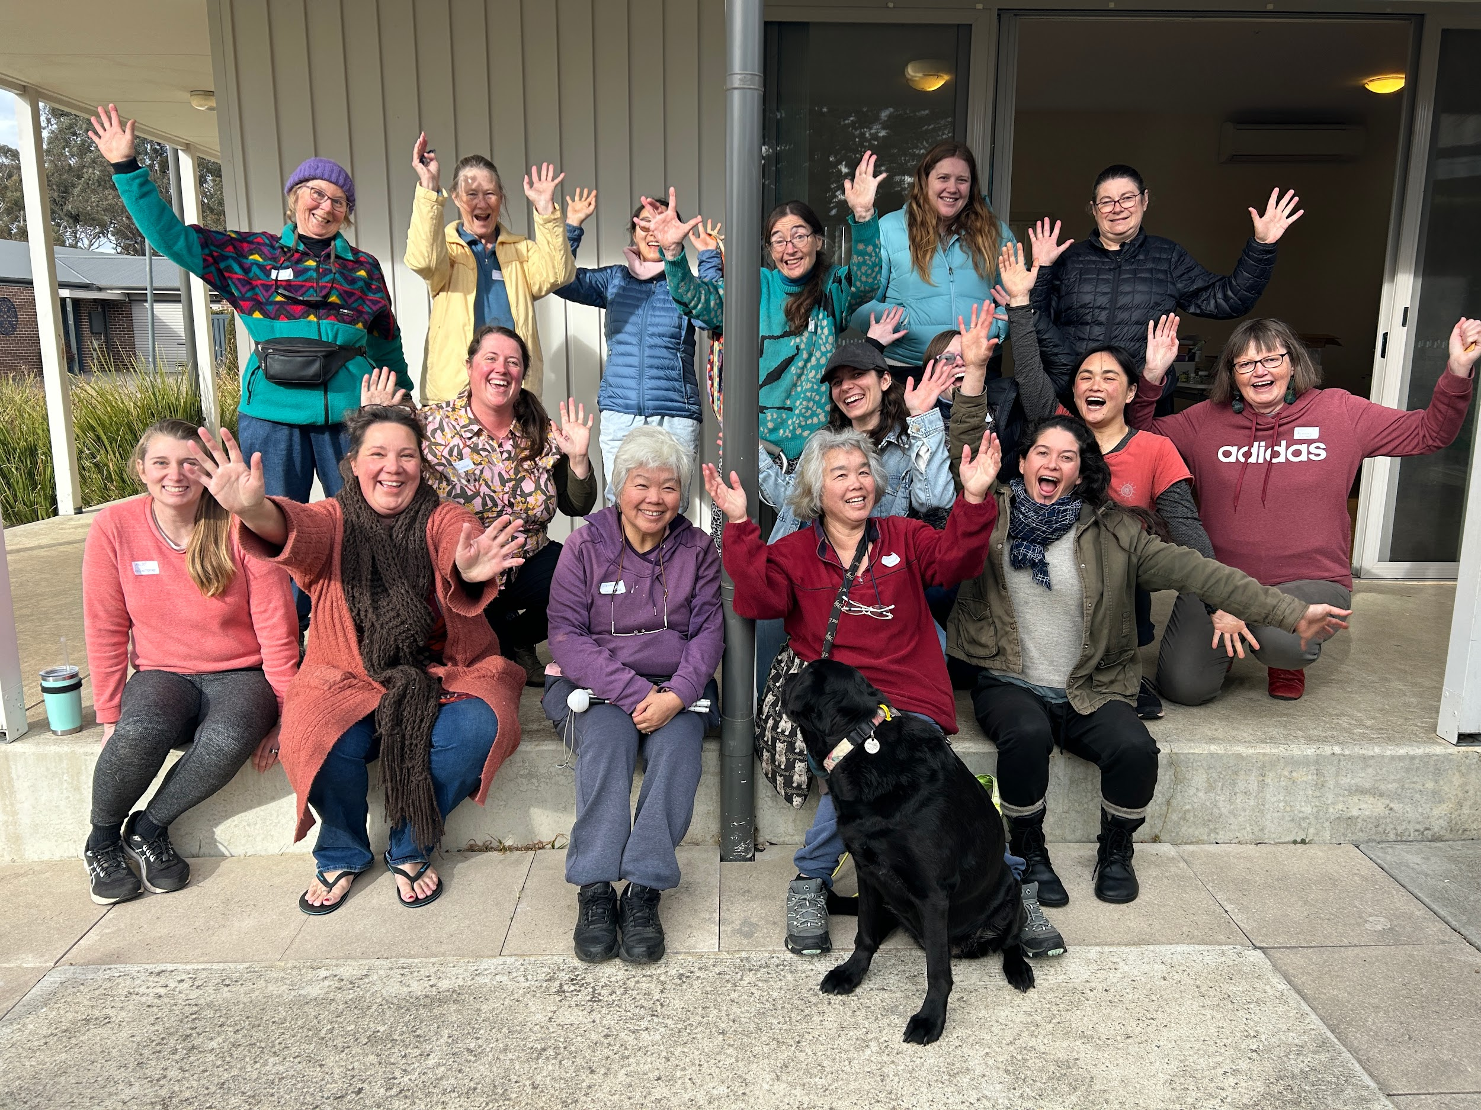
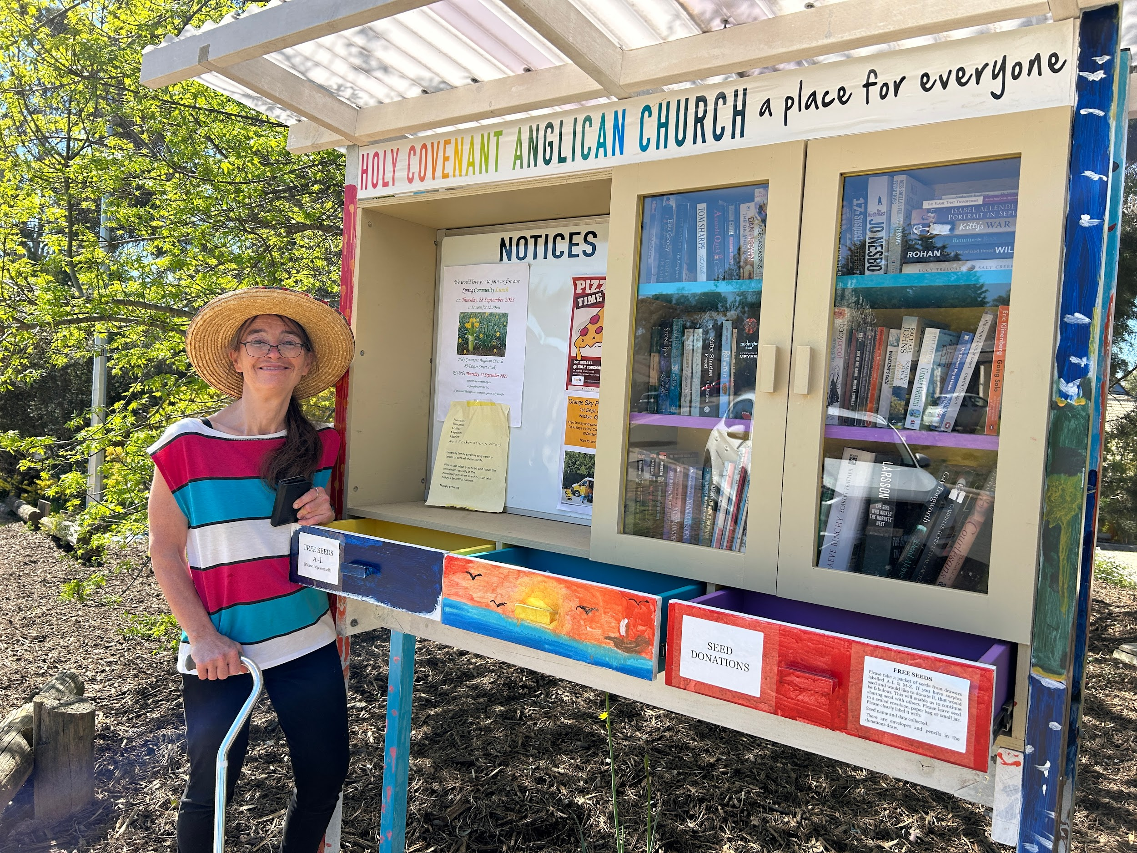
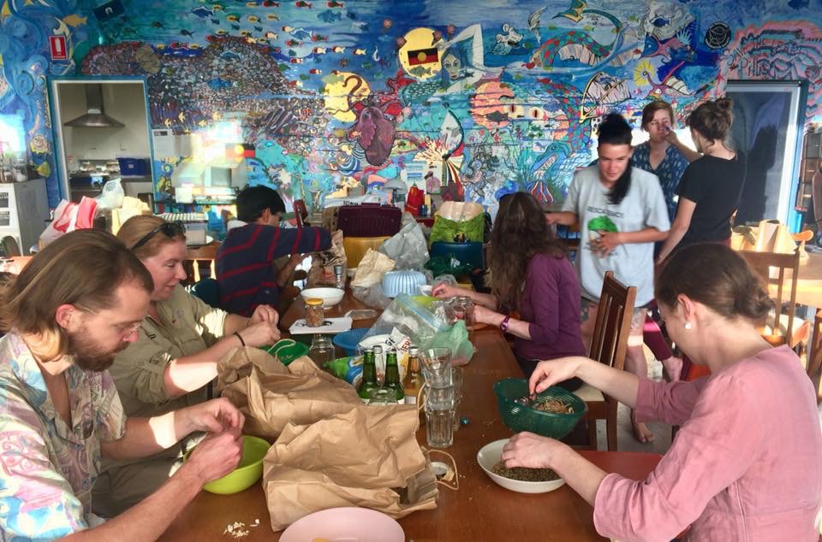

Slide 5
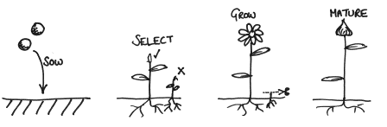
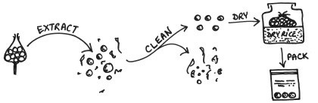
The simple process of seed saving
Picture attribution: www.realseeds.co.uk
Start with ‘good seed’: open-pollinated (not hybrid or GMO), locally grown, not chemically treated, from a reliable source.
Help the plant to have a long, happy, healthy life and to grow old gracefully.
Harvest, clean & dry the seeds and store in dark, temperature controlled, dry conditions.
Notes:
From seed to seed.

Slide 6
THE golden rule of seed saving
Save seeds from the strongest plants, that produce fruit or edible parts earliest, bolt to seed last, have the tastiest fruit (or have the best tasting leaves), are most productive, and that have the characteristics you want future plants to have.
Your observations, choices and decisions impact the plant’s future generations. Save seeds from plants that are what you want for your garden and table in the seasons to come.
Notes:
When you save seeds, you are part of the breeding cycle of the plant. To varying degrees (and with varying levels of difficulty), you can breed the characteristics into the plant you want its future generations to have.
Importantly, you want to not save seeds from the leafy plants that ‘bolt’ to seed earliest – the coriander or lettuce that goes to seed two weeks after you plant it will breed more lettuces and coriander that don’t grow into healthy, edible plants before they set seed.
BUT, you do want, for example, tomatoes and chillies that set fruit early.
It takes some thought and observation. And patience.
This can happen by design – or by accident!

Slide 7
There’s a couple of considerations…
For genetic robustness, outbreeders need lots of friends - the number depends on the plant (population size)
Trait characteristics need to be clearly identified and understood (selection)
Some plants will easily cross-pollinate - by insects or wind (isolation)
Hybrid (F1) and GMO seeds won’t work (starter seed selection)
But overall, it’s pretty simple…
Start now with lettuce, peas, beans, tomatoes, coriander - easy peasy!
Take a planned approach to pumpkins, zucchinis, cucumbers, silverbeet… and a few others!

Slide 8
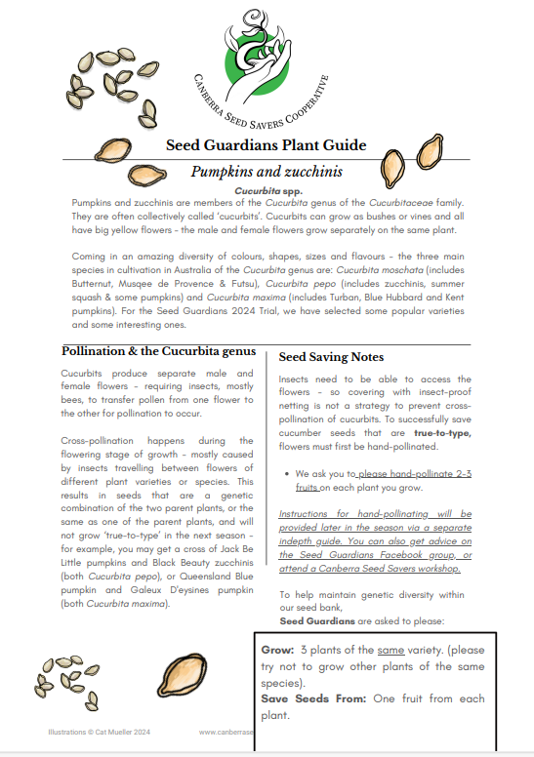
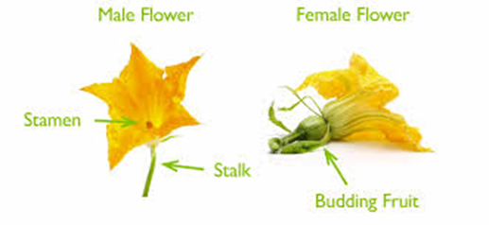
Cross-pollination adds some extra challenges. And it’s not just pumpkins!
Strategies: hand pollinate, separate by distance, by flowering time or use a barrier to exclude pollen being transferred by insects/ wind.
Or… you can not worry about it too much and see what is produced!
Notes:
Seed saving - make accessible, how easy it can be and how much fun it is to learn the more involved parts; the wonder of nature and the bounty she produces
Why save seed? Cheaper, biodiversity,

Slide 9
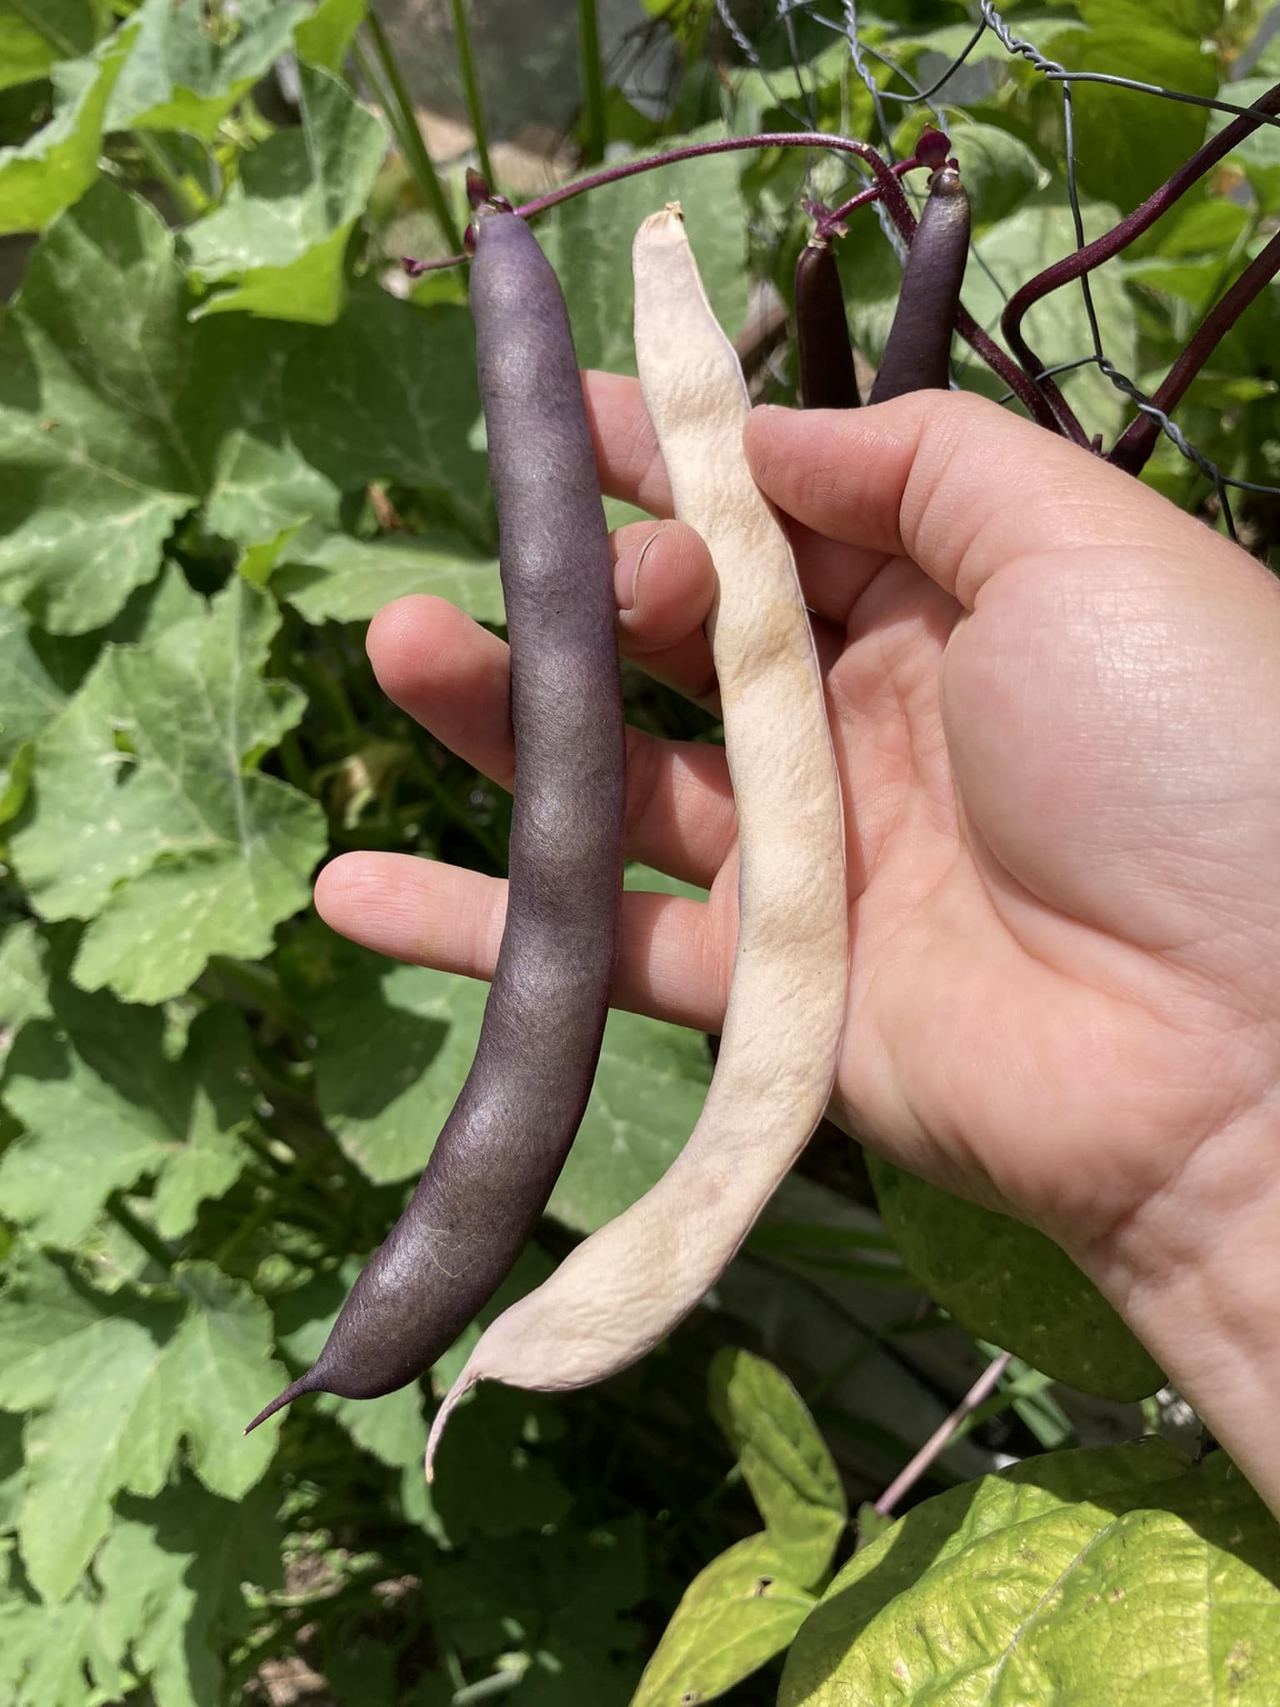
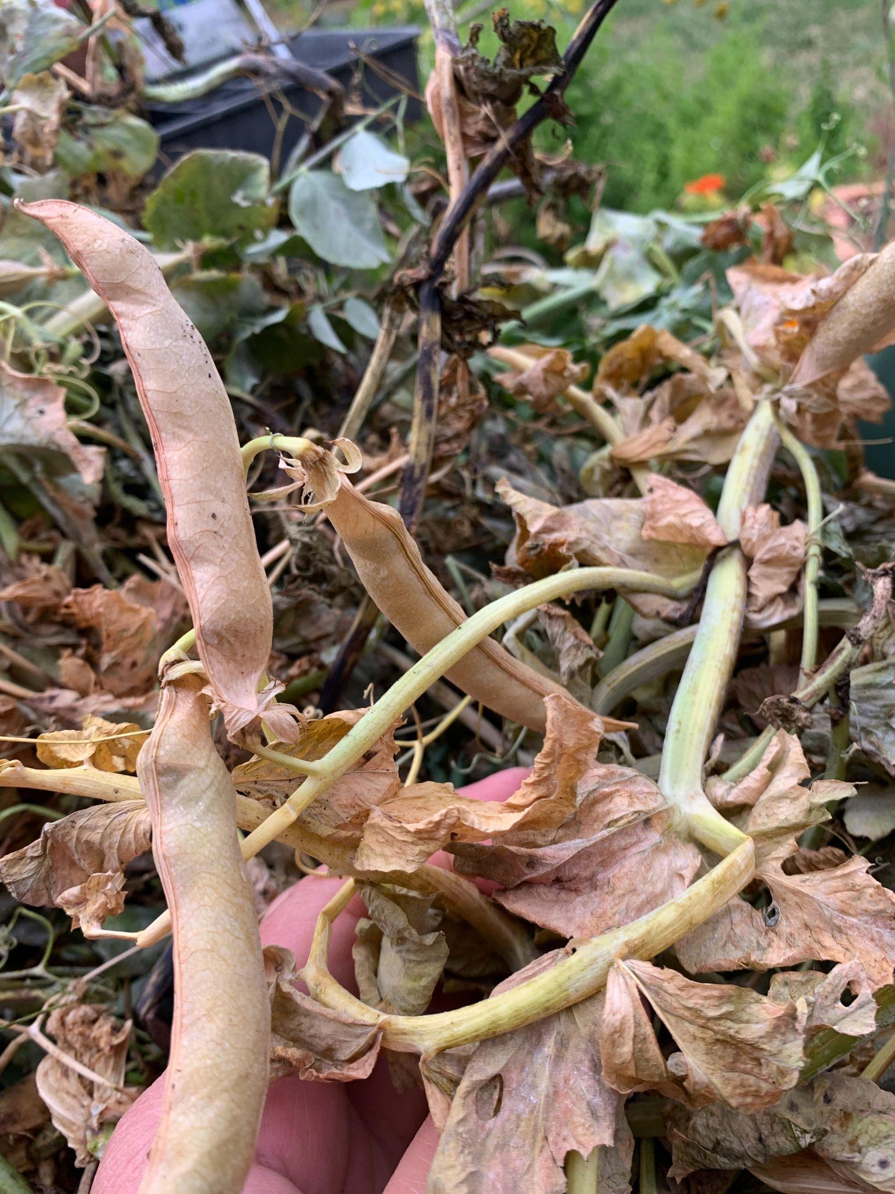
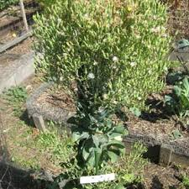
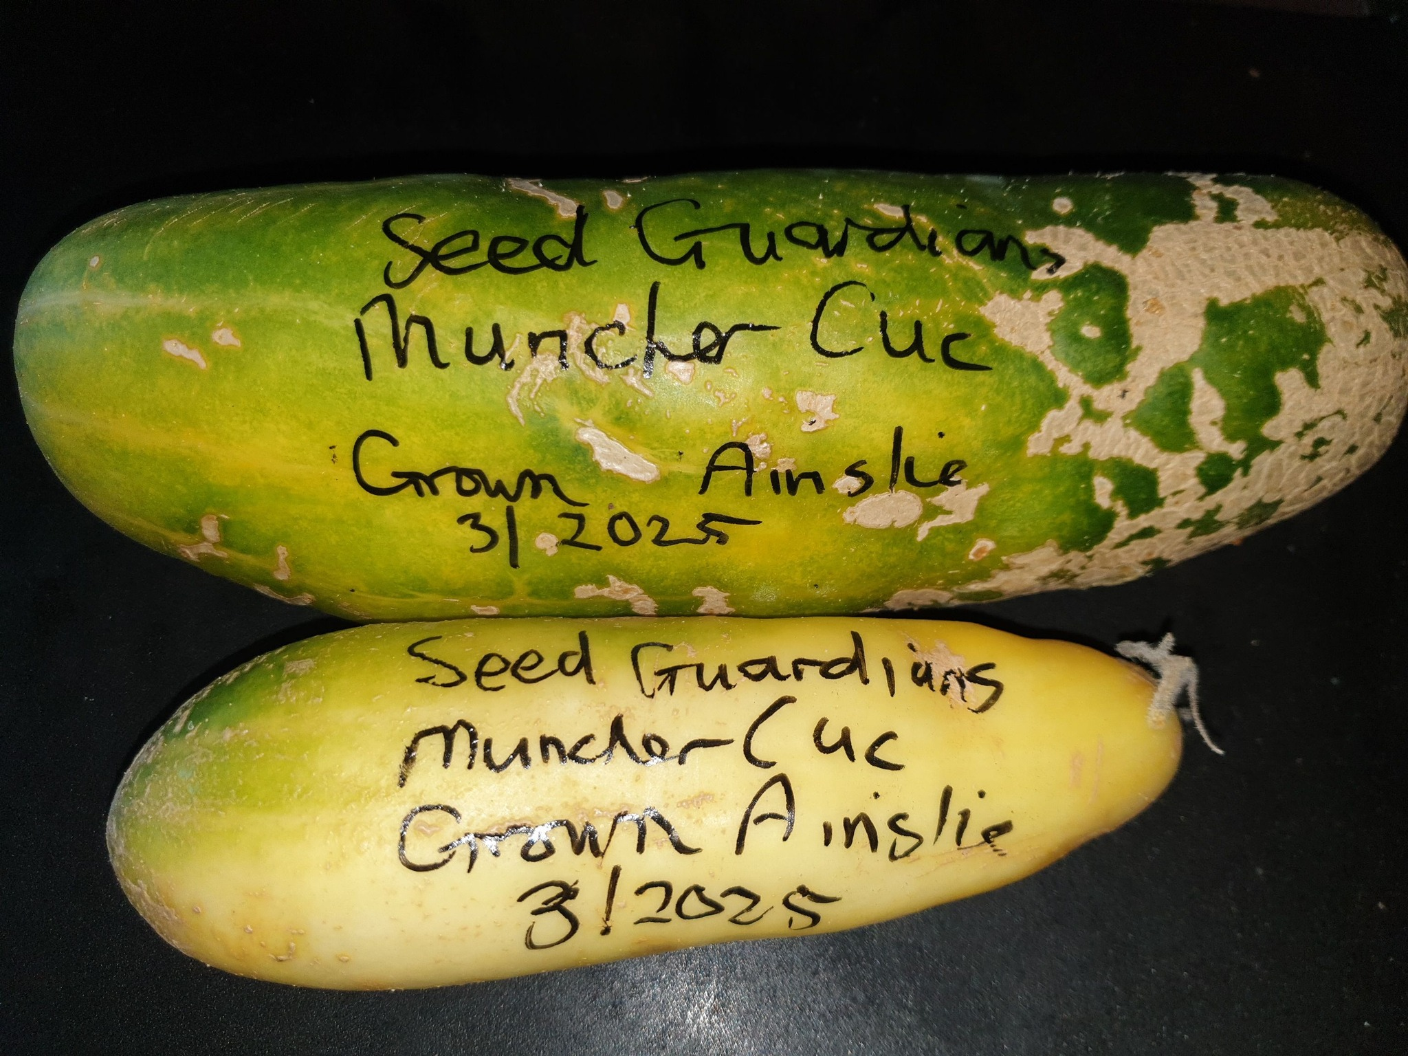
It can take quite a while and you MUST wait for plant, fruit or seed maturity.
The riper, the browner, the deader, the cracklier, the uglier the better!

Slide 10
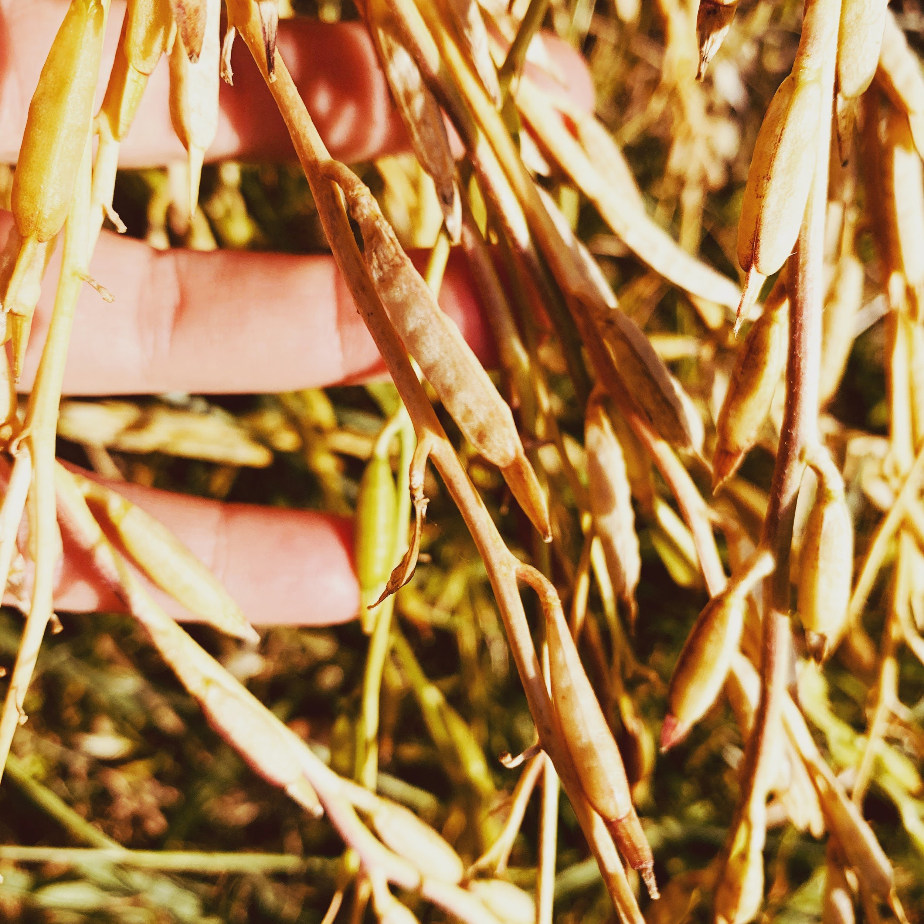
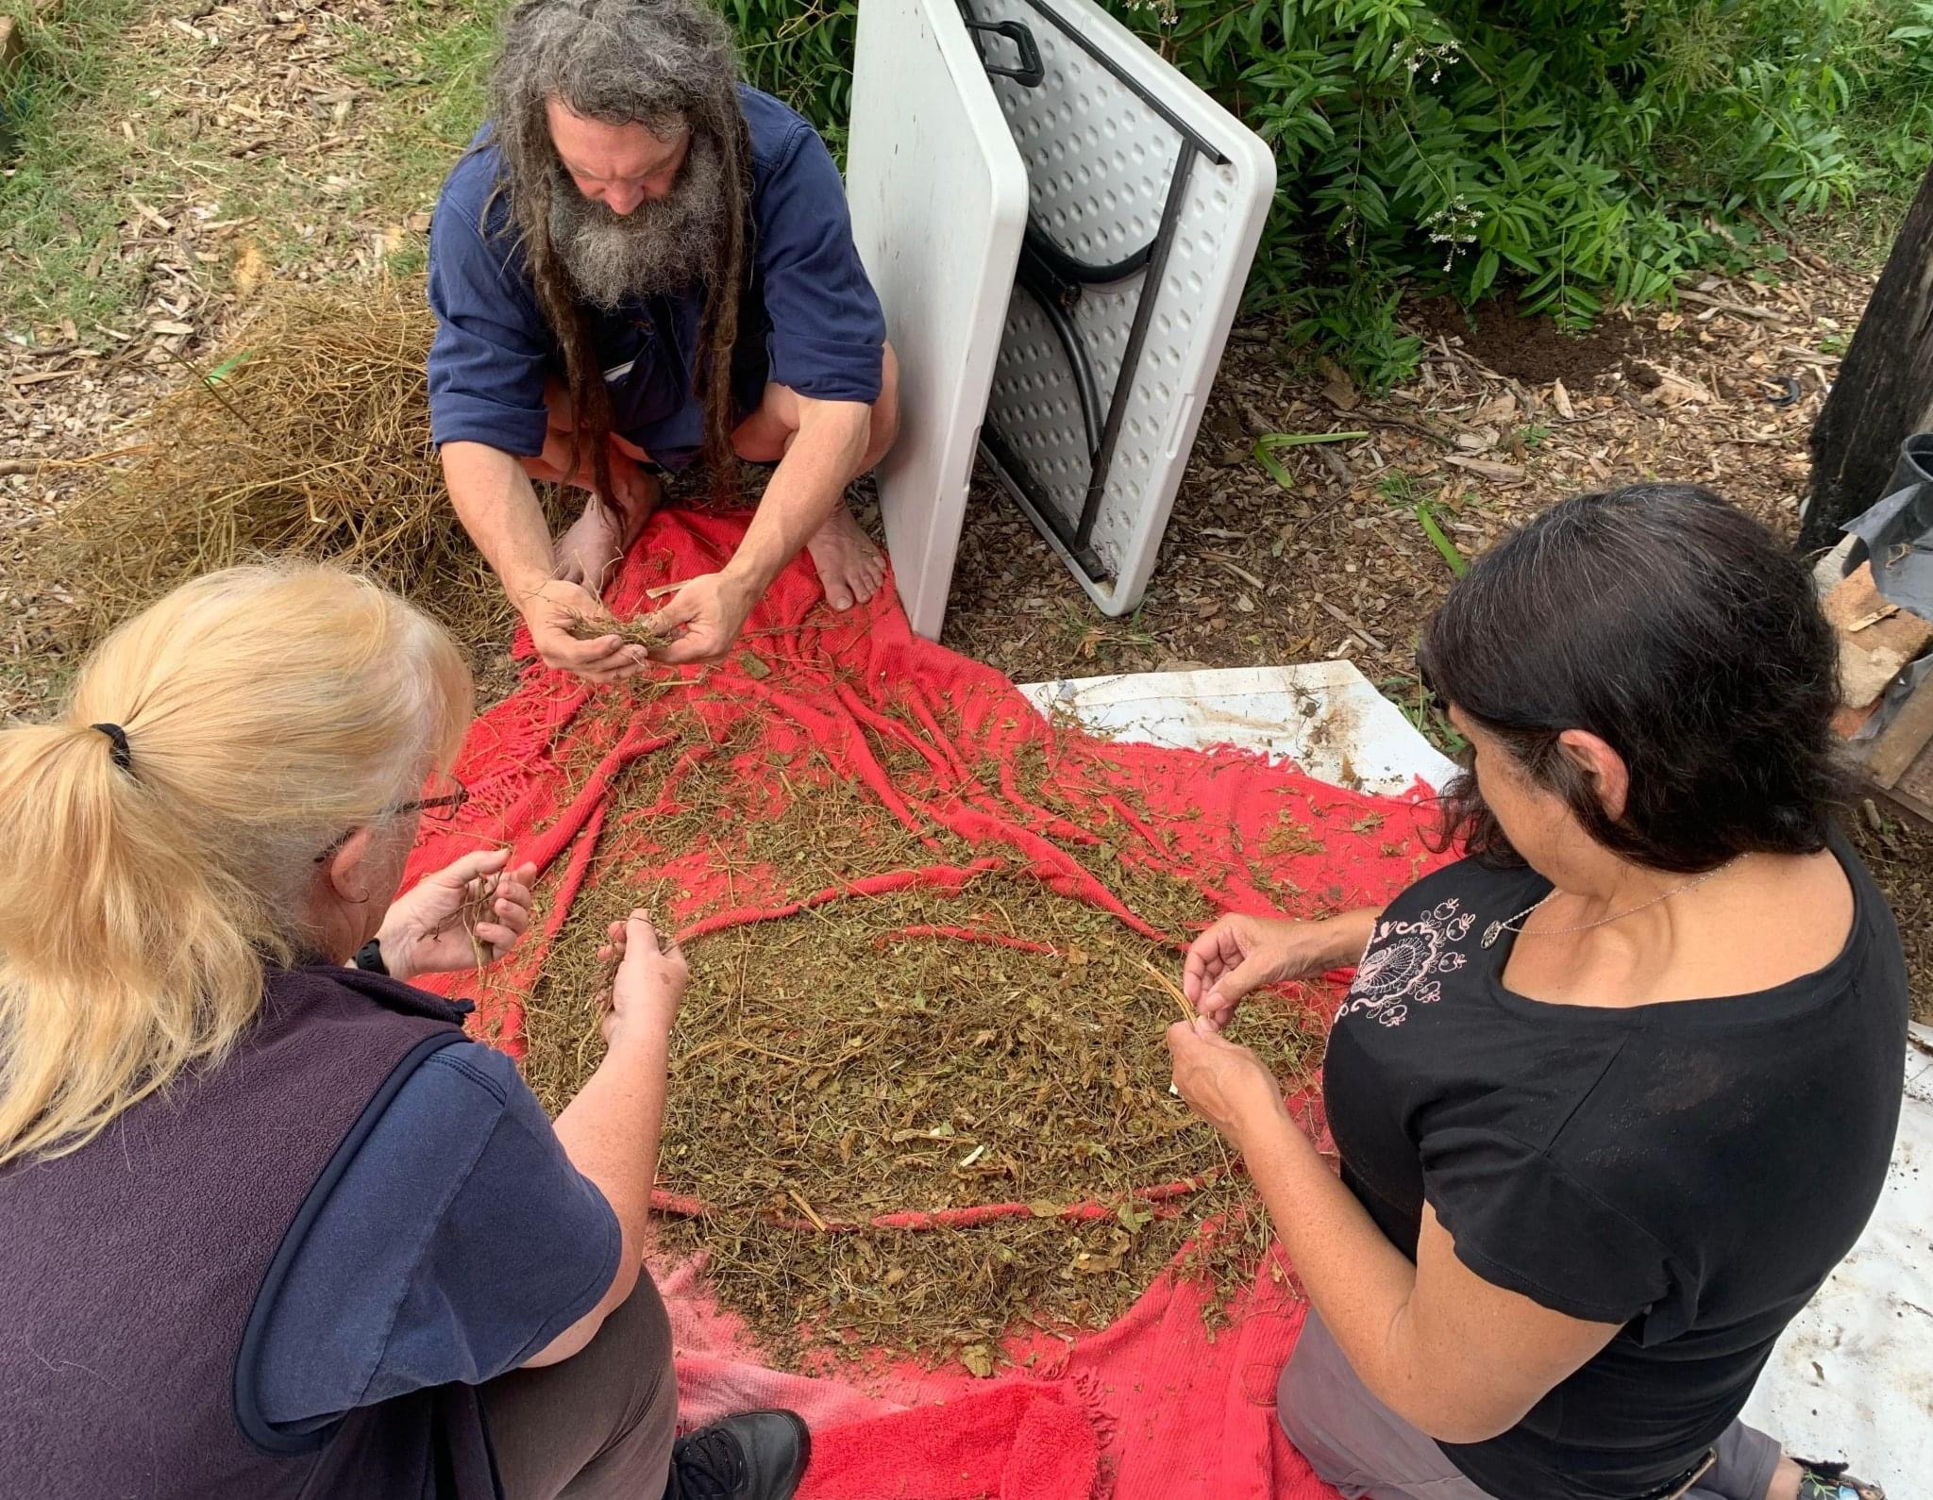
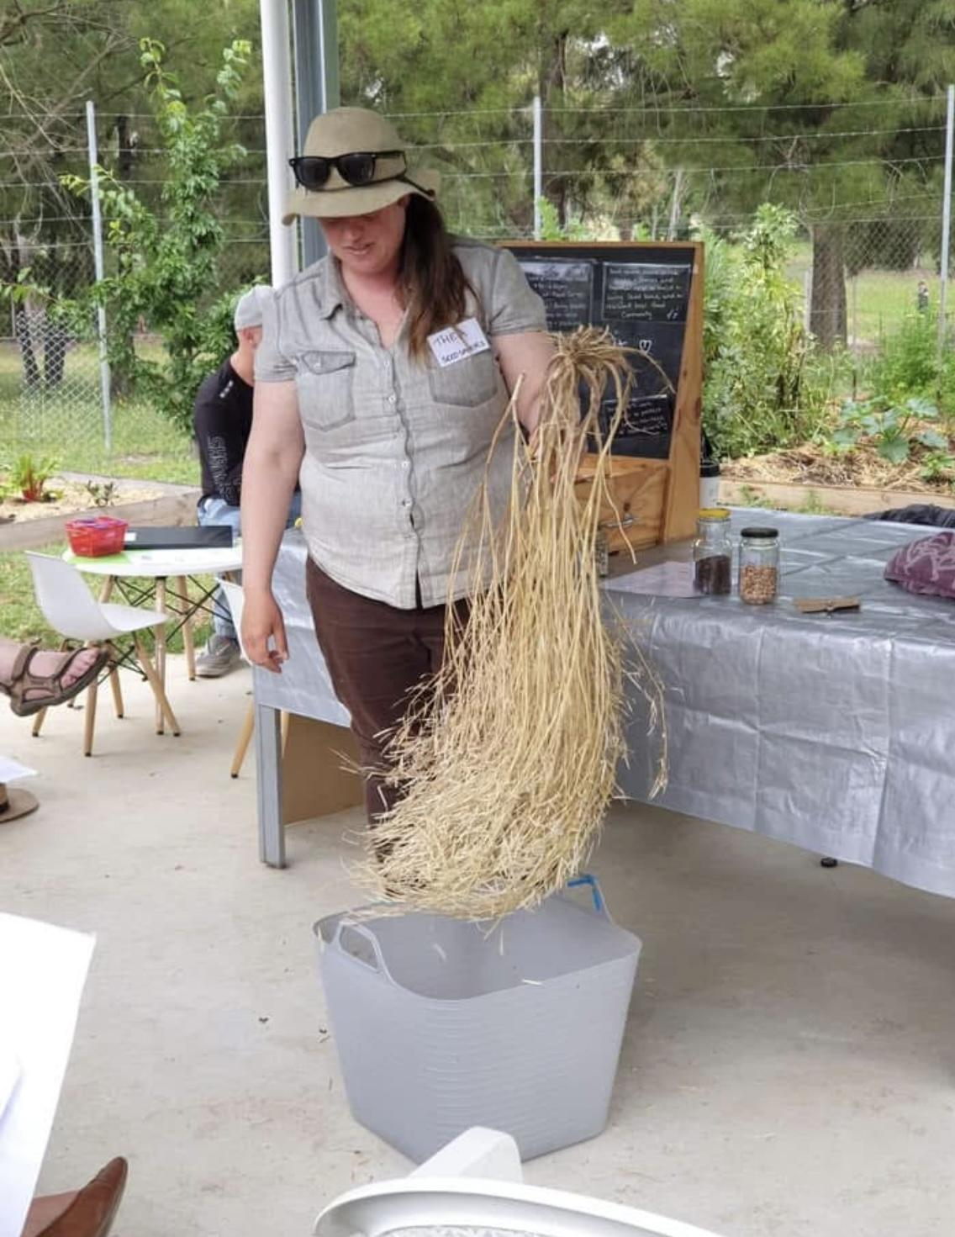
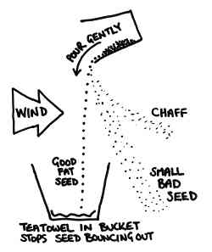
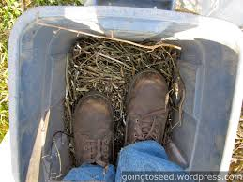
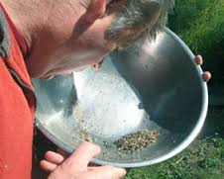

Processing Part 1: Dry Method/ Winnowing
Crush the dried seed heads or pods
Separate the chaff from the seeds – called ‘winnowing’
Pictures from www.urbanfoodgarden.org
Notes:
Lots of herbs like coriander, dill, parsley are great for easy winnowing – they produce seeds on the end of stalks in umbels. If left to dry thoroughly, they will separate easily from the plant by cutting the seed heads off at the stalks, hanging upside down in a paper bag for a while and then shaking. The seeds will fall off into the bottom of the bag.
Rocket and brassicas will produce small round seeds in pods that should be left to dry thoroughly on the plant until the pods almost split open by themselves (or “shatter”). When cut off at the stalks, turn into a paper bag and rub the pods thoroughly between your hands to separate seeds from pods. Seeds weigh more than pods so wind winnowing can be the easiest method to separate the seed from the chaff – see the diagram on the slide or picture of bloke blowing chaff out of a bowl.

Slide 11
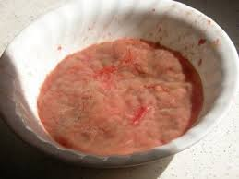
Processing Part 2: wet method/fermentation
All methods: cut open → scoop out pulp + seed
Then either dry, wash or ferment
Dry: spread out to dry on paper towel for a few days
→ label and store
Wash: wash seeds with water and sieve to remove
pulp → dry → label and store
Ferment: pulp + seed → bowl with some water → cover → ferment for 2-3 days → wait for scum to form on top of water → rinse and rub through sieve to clean the seeds → clean and dry, label and store
Notes:
Washing or fermenting?
Some seeds such as tomato and cucumber are in fruit in pulp
These seeds can be scooped out of a mature fruit, washed and dried
Some, such as tomatoes, have a coating on them and will benefit from having that fermented before seeds are washed and dried
cut open → scoop out pulp + seed → bowl with some water → cover
leave for 2-3 days and it will ferment with scum on top
rinse off and rub through sieve to clean the seeds
clean and dry, label and store

Slide 12
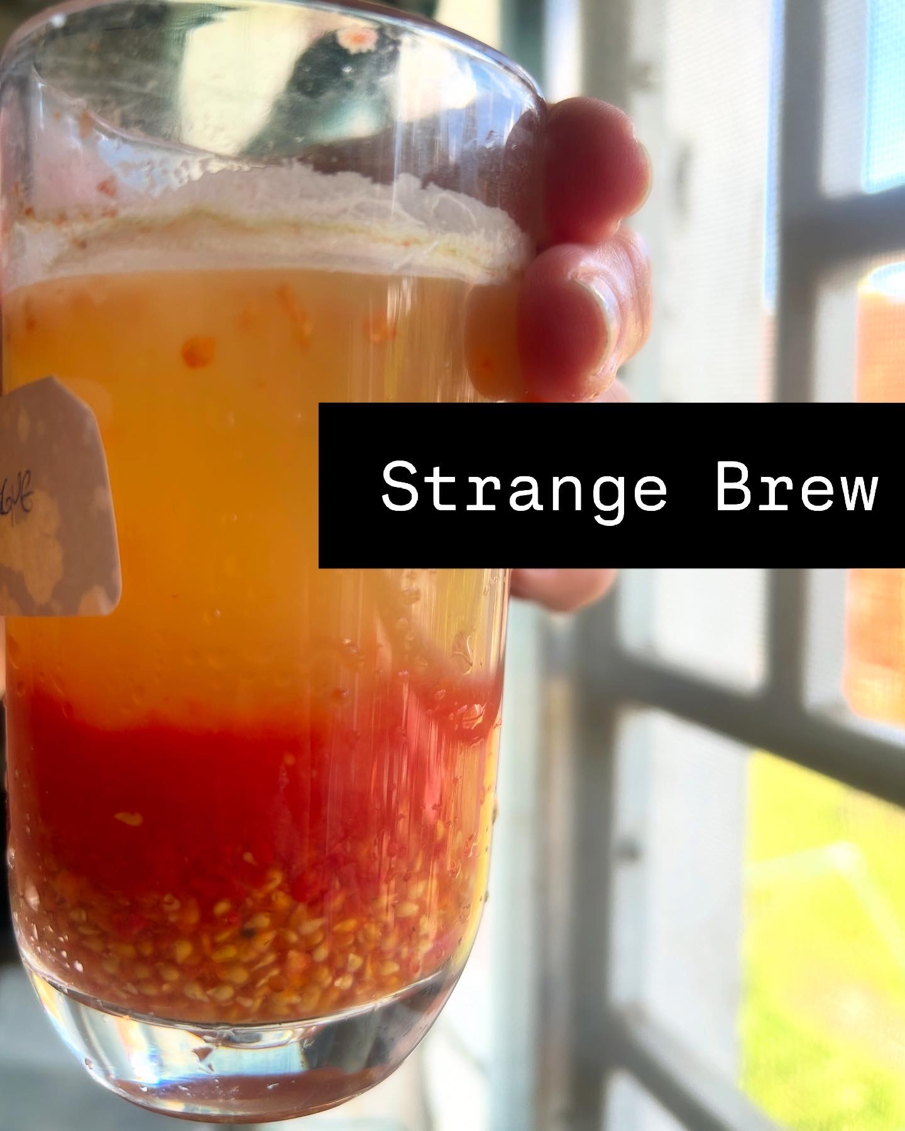
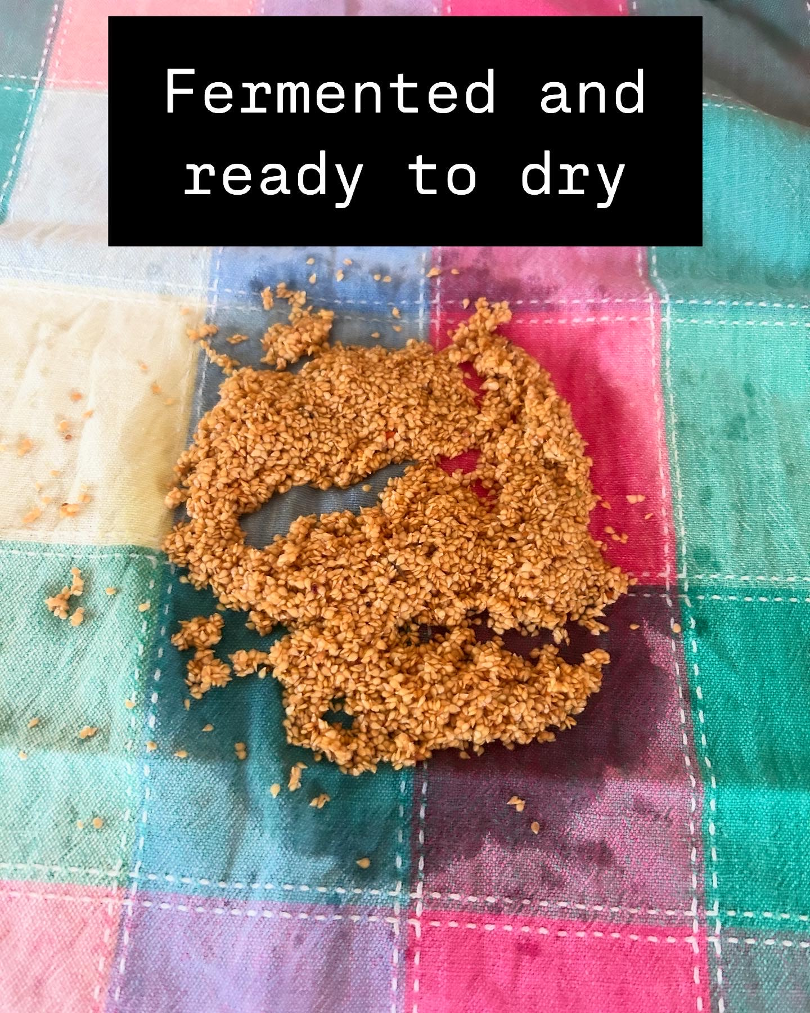

Slide 13
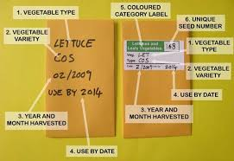
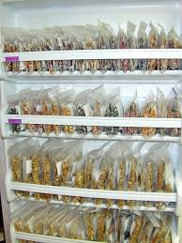
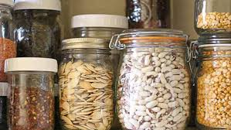
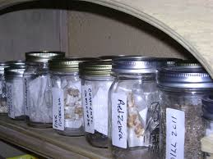
Storing Seeds
Viable for different lengths of time - parsnips v tomatoes; conditions of storage
Must stay DRY and be clean – sealed, roasted rice, desiccant packets, glass or plastic containers
Label everything – variety (with latin name), date of harvest, location
Notes:
Some seeds are viable for only 1 year – parsnips, hello!
Some seeds have been found to viable after 30 years – think of the stories of old varieties of tomato smuggled into the country or found in an old box in the shed.
Generally viability decreases over time. Affected by storage conditions.
If you find some old seeds, don’t throw them out – plant them and see what happens!
Remember to label everything! Date, latin name, common name, where grown, likely use-by date, any notes about growing season/ plant. You will forget!
Storage MUST be dry and cool. Moisture will potentially cause the seeds to start germinating (and then die). Dryness is about the initial drying process – air, don’t cook, some can go in the sun, some should be in the shade; and also about storage – glass jars with roasted rice grains is a great way to store.
Think about keeping your seeds where you keep your wine – relatively stable climate controlled and dry.

Slide 14
